Slide 1
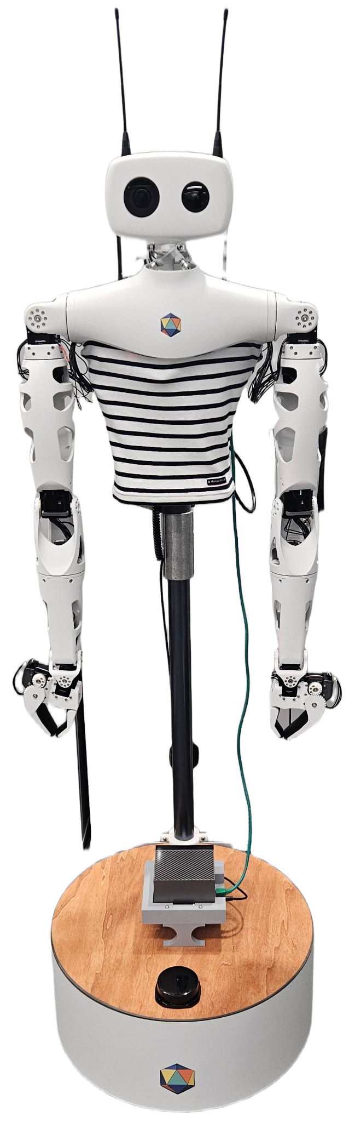


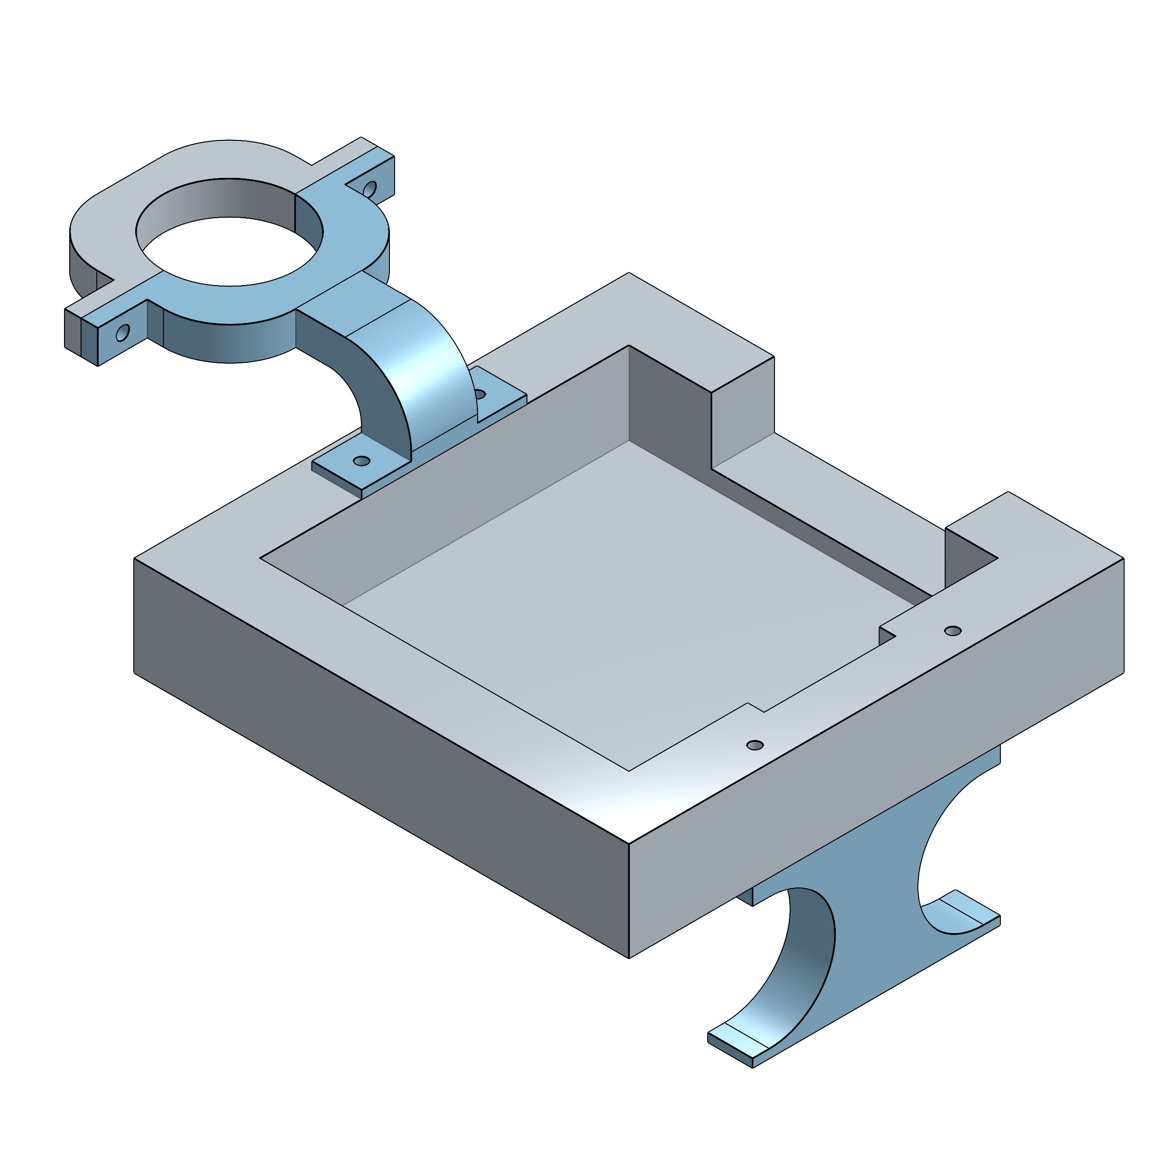
Mounting An AGX ORIN Onto A Reachy Robot
By Adam Parsons (ParsonsA10@cardiff.ac.uk) | Supervisors: Victor Romero Cano, Emin Safa Tok
Overall goal
This internship focused on integrating a Jetson AGX Orin Developer Kit onto the Reachy robot by learning both platforms, programming Reachy in Python, designing a 3D-printed holder for the Orin, and creating a step-by-step integration guide
Process
Setting up Reachy
Connect the reachy to monitor (HDMI).
Assign a static IP (I used 192.168.100.1) for Reachy.
Disconnect Reachy from the Monitor
Setting up the AGX
Connect the AGX to the K&F battery (DC cable) and a monitor (HDMI).
Using the initial startup flash the AGX’s system
Install Python 3.8 along with the Reachy SDK and ROS 2.
Assign a static IP (I used 192.168.100.100) for the AGX.
Physical Mounting
Connect AGX Orin to Reachy via an Ethernet cable.
Verify connectivity by pinging Reachy from the AGX Orin.
Secure K&F battery inside Reachy’s base with Velcro, routing cable through pole gap.
Assemble the 3D-printed holder:
Attach Clamp Piece 1 (part 2) and Legs (part 4) to the Tray (part 1) using 3 mm screws.
Attach the holder onto the support pole using Clamp Piece 2 (part 3) with 3.5 mm screws.
Insert the AGX Orin into the holder to complete the mounting process.
Background
Before integrating the two computers, I reviewed Reachy’s documentation to understand its components and connection methods. Using a workstation PC and Wi-Fi, I developed code for teleoperation with an Xbox controller and tested waypoints and basic arm movements.
I also designed a custom holder for mounting the AGX Orin to Reachy’s base using the Onshape CAD modelling and researched compatible wires and batteries to power it.
Equipment
The following equipment was used in the process of mounting the AGX Orin onto Reachy:
Nvidia Jetson Orin AGX
K&F Concept 99Wh Battery
SZRMCC USB-C to DC Power Cable Ethernet cable
HDMI cable
Monitor
4 × 3 mm × 40 mm screws, 4 × 3 mm nuts, 4 × 3 mm washers
2 × 3.5 mm × 15 mm screws, 2 × 3 mm nuts, 2 × 3 mm washers
Links:
Documentation:
GitHub repo:
CAD Model
I designed a 3D-printed holder with four parts:
1. Tray – Secures the AGX Orin, with slots for power buttons and port access.
2/3. Clamp Pieces (1 & 2) – Attaches around Reachy’s support pole to hold the tray firmly.
4. Legs – Raises the tray to avoid obstructing the LIDAR sensor.
3
2
1
4

